Slide 1

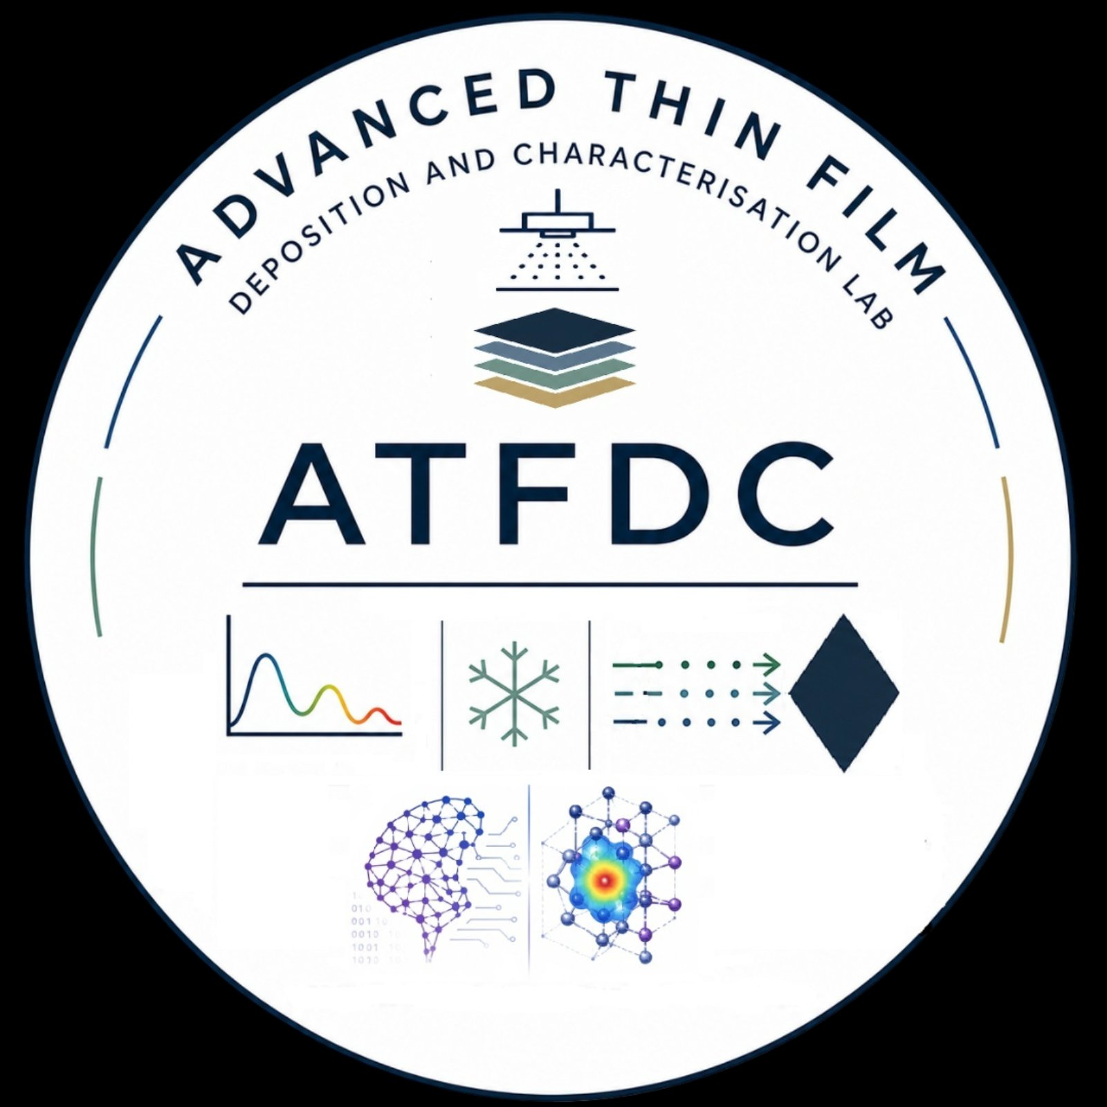


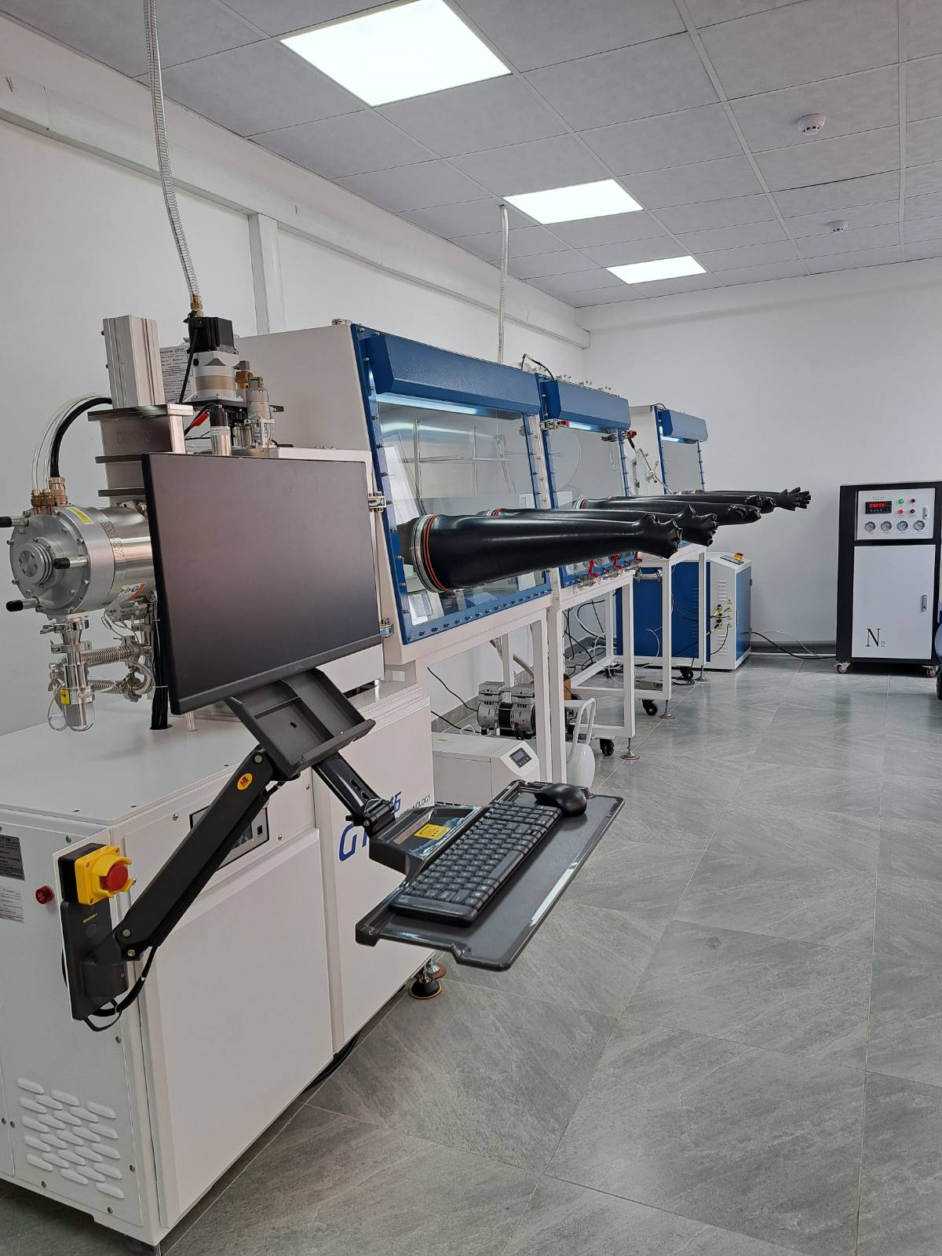
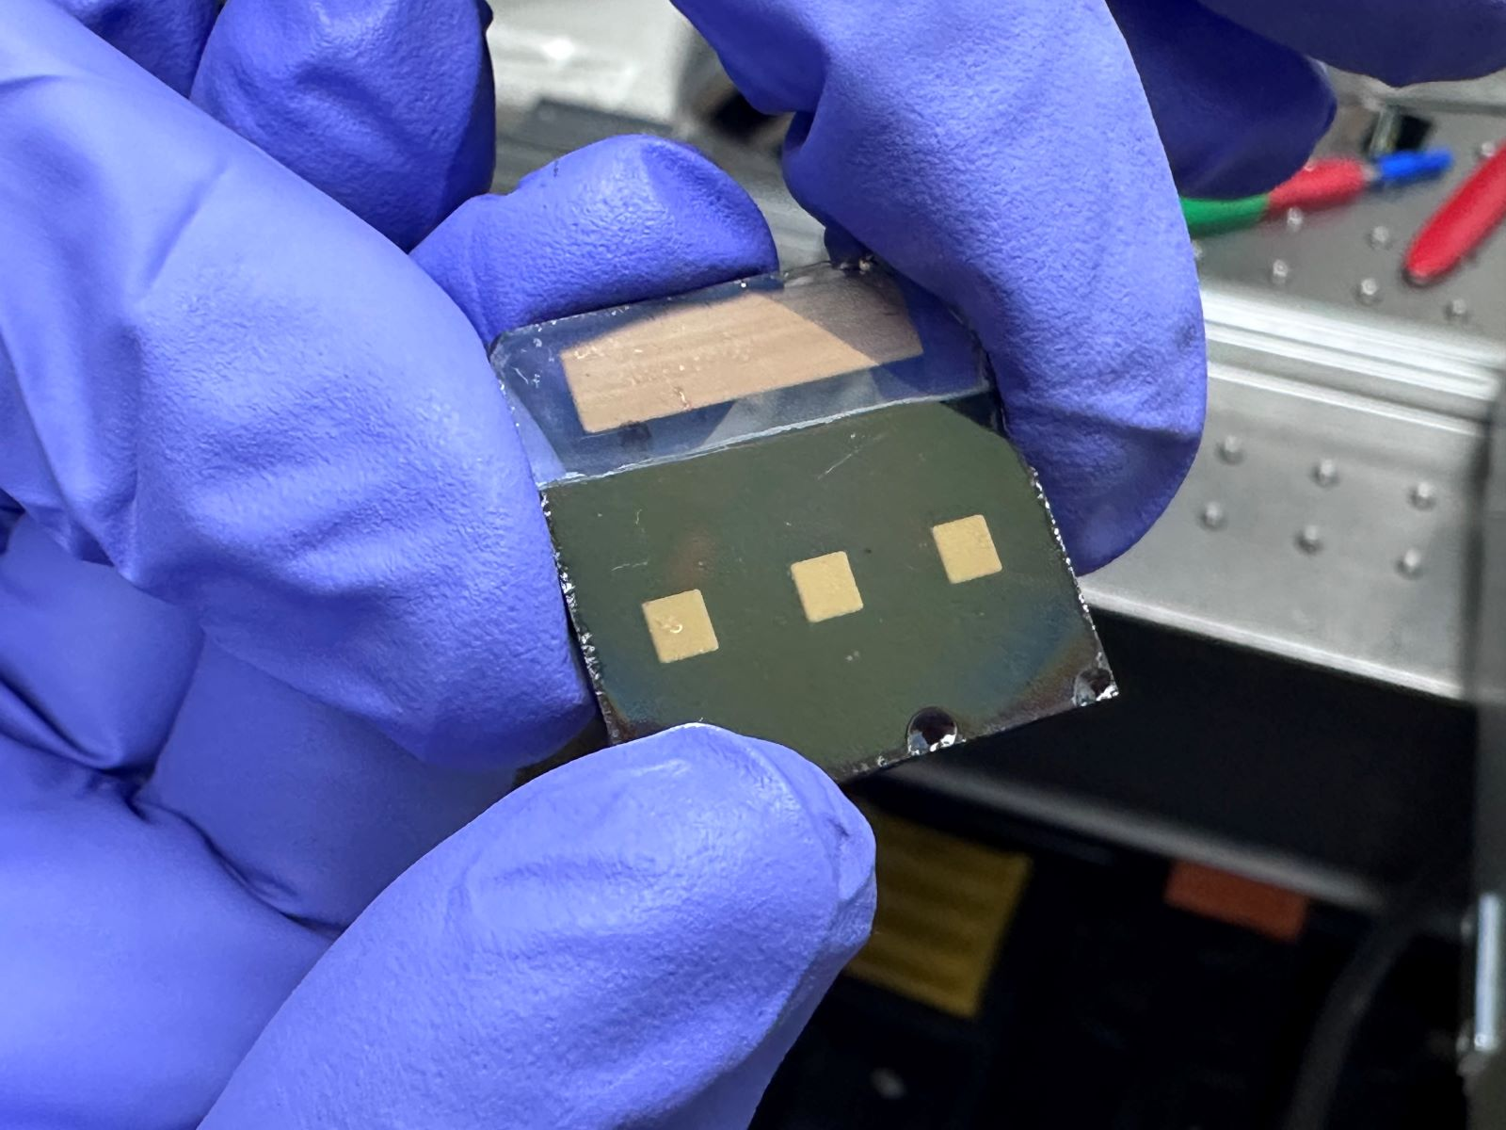
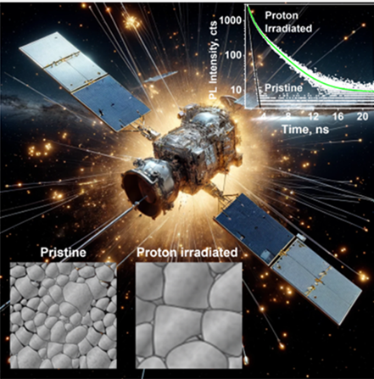
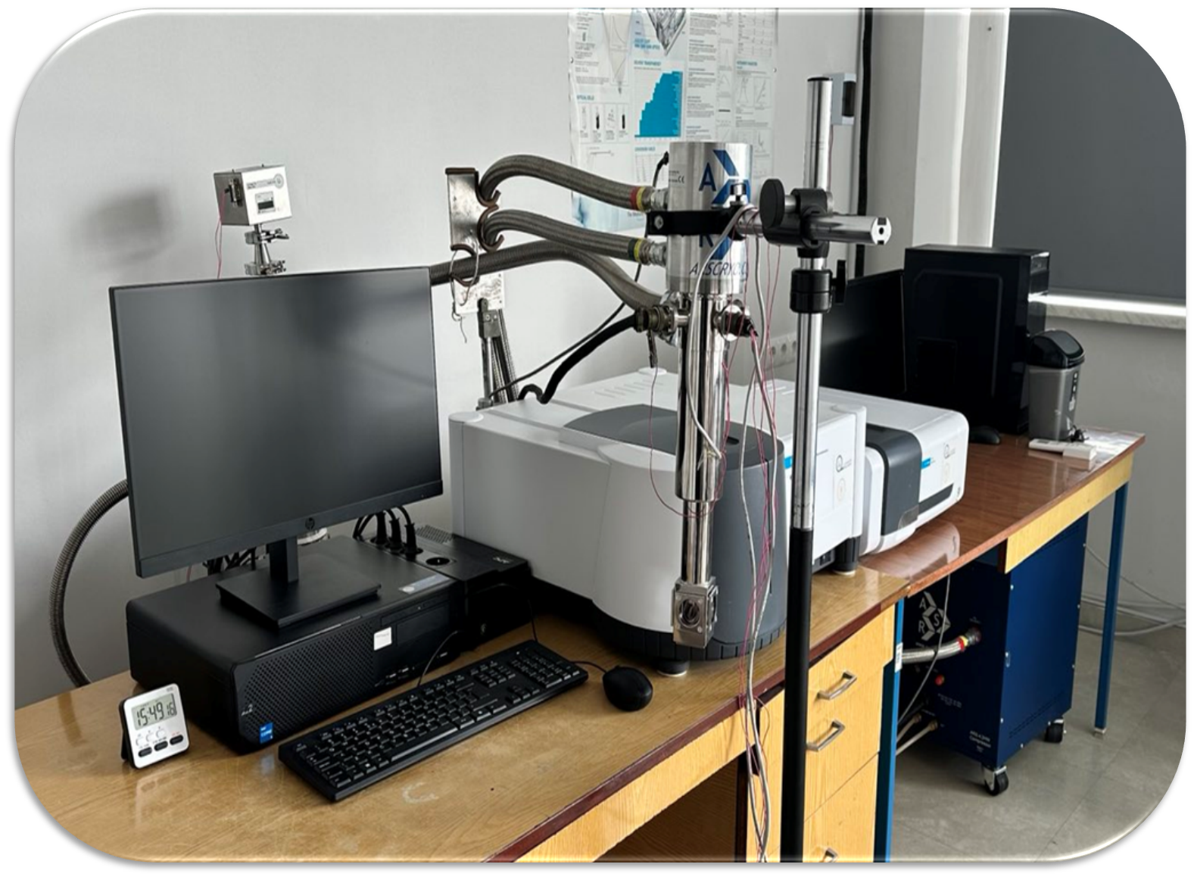
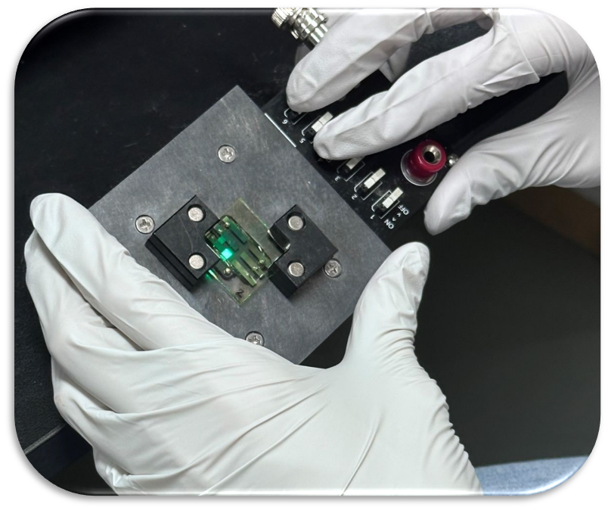
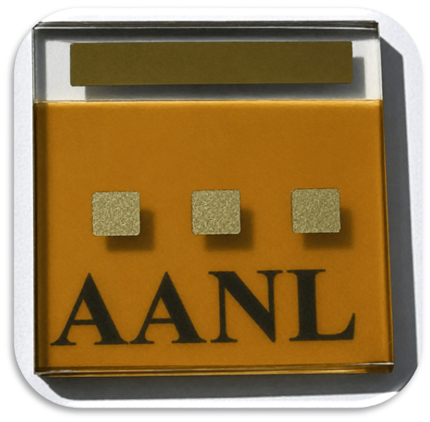
Thin film technology: from microelectronics to high-efficiency solar cells
Anush Badalyan

Slide 2
Semi-transparent and opaque Solar Cells
Synthesis
Thin film deposition
Optical characterization
Structural characterization
Morphological characterization
Irradiation with protons and electrons
Solar Cell
Au
SPIRO
Perovskite
FTO
TiO₂ BL
TiO₂ mp
TiO₂ CL
Glass

Slide 3
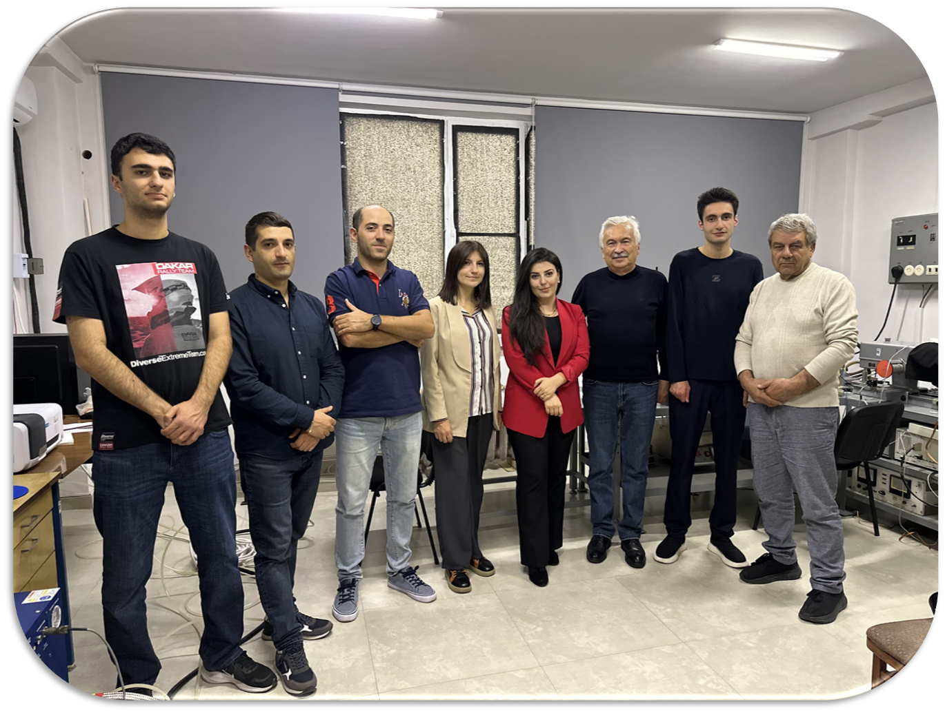

Our team
Eduard Aleksanyan - Dr., PI, AANL
Norik Grigoryan - Dr., AANL
Anush Badalyan - Dr., AANL
Arevik Arestakyan - PhD student, AANL
Artur Papikyan - PhD student, AANL
Hrant Yeritsian - Bachelor's student
Arman Hovhannisyan - Bachelor's student
Artavazd Kirakosyan - Dr., Chungnam National University, South Korea

Slide 4
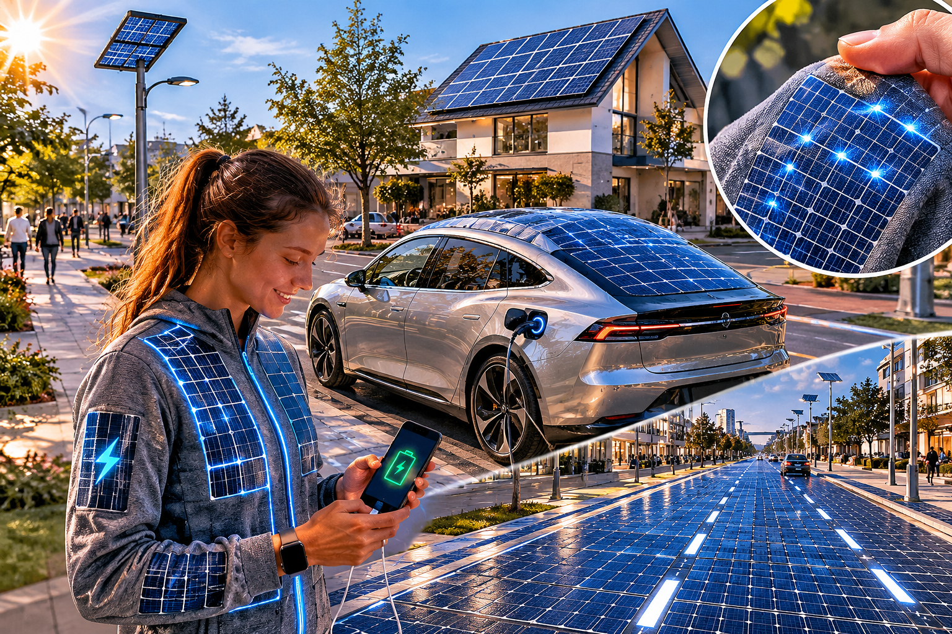
Thank You !!!
The future will see everyday objects such as clothing, the rooftops of cars and even roads themselves turned into power-generating solar collectors.
Acknowledgments
The work was supported by the Science Committee of RA, in the frames of the research project № 24LCG-1C025.

